Slide 1
Transfer to Secondary School September 2025

Slide 2
Choosing a school
Have you
started
looking
at schools
yet?

Slide 3
Choosing a school
How do I know which school is right for my child?
Who can help me make that decision?

Slide 4
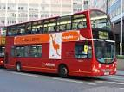
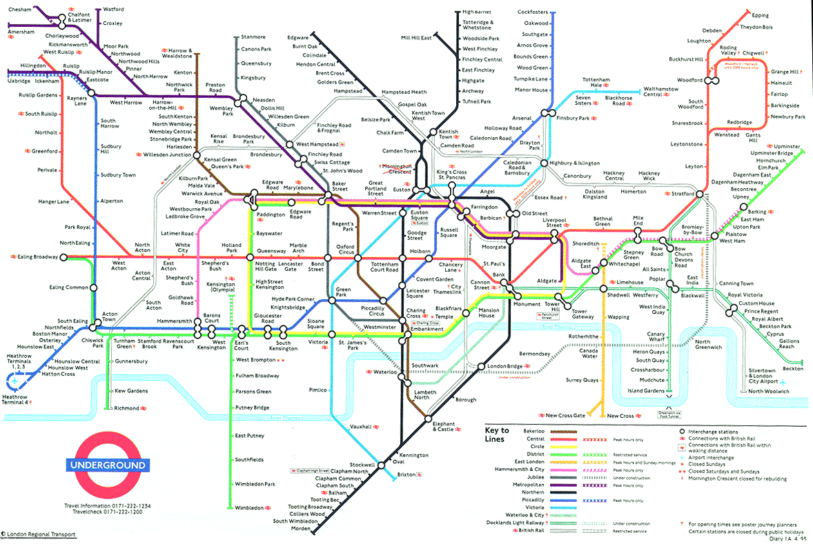
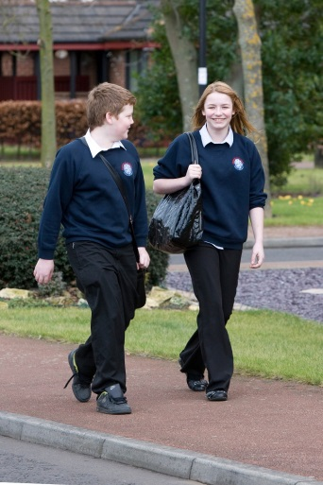
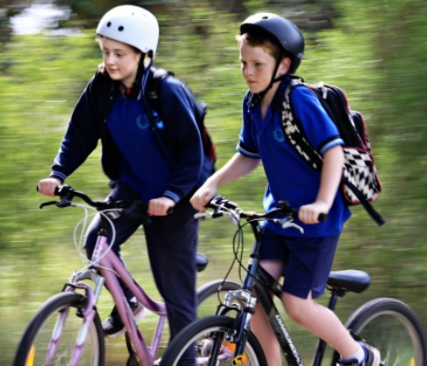
Choosing a school
Talk to your child
find out what they want
consider how they will travel to school

Slide 5
Choosing a school
Visit the schools
Attend open evenings
Talk to the teachers
Talk to the pupils

Slide 6
Choosing a school
It will have detailed information about:
Read the school prospectus
how the school is run
which subjects are taught
the admissions criteria
The prospectus will be available at the open evenings.
You can also download from the school website.

Slide 7
Choosing a school
Read the secondary education guide
(published by your home local authority)
The 2025 guide will be available online, in September 2024
Download Barnet’s guide from the Local Authority’s website

Slide 8
Choosing a school
Talk to the Customer Service Team
the team can offer you advice and answer your questions
how do I contact them?
tel: 020 8359 7651
Contact Us online
If you live outside Barnet, visit your Local Authority’s website

Slide 9
Choosing a school
Look at performance information online
the latest Ofsted reports are available from the Ofsted website www.ofsted.gov.uk
achievement and attainment tables are available at www.gov.uk/school-performance-tables

Slide 10
Choosing a school
Look carefully at the admission criteria for each school
selection by aptitude
faith criteria
siblings
distance
Remember most schools get more applications than they have places available.………

Slide 11
Choosing a school
Geographical distance for most schools that were unable to offer to all applicants on Secondary National Offer Day 2024
Name of School | Furthest distance offered (Miles)
Archer Academy | 0.223 (N2) 1.295 (N3) 1.038 (NW11)
Ark Pioneer | 1.409
Ashmole Academy | 0.534
Christ College, Finchley | 1.39
The Compton School | 1.008
East Barnet | 1.05
JCoSS | 1.099
Mill Hill High | 1.078
Queen Elizabeth’s Girls’ | 4.263
Saracens High | 0.928
The Totteridge Aacdemy | 1.546
Wren Academy | 0.359
Full Secondary 2024 Allocation Table can be viewed at:
https://www.barnet.gov.uk/schools-and-education/school-admissions/apply-secondary-school/transferring-secondary-school

Slide 12
How do I apply?
How soon can I apply?
The application process begins on 1 September 2024
Where do I apply?
apply online at www.eadmissions.org.uk

Slide 13
How do I apply?
How many schools can I apply for?
Can I apply to schools outside Barnet?
You can apply for up to six schools
You must rank the schools in your order of preference
It is important to think carefully about the order as you will not be able to change it after the closing date
Yes, you should include all your preferred schools, whether inside or outside the borough where you live

Slide 14
How do I apply?
Choosing school preferences sensibly
if you only list one school, it will not increase your chances of getting a place at the school and your child will be considered for that one school only
if this is unsuccessful, you may miss out on an offer which could have been made at another school which may no longer be available
it is important to make realistic school choices to avoid disappointment
check how places were offered last year, but remember the cut-off distances are just a guide and will change every year
just because you live nearer to the school than the last child offered a distance place last year, it doesn’t mean your child is guaranteed a place.

Slide 15
How do I apply?
Do I need to fill in any other forms?
All voluntary aided schools and some foundation schools, free schools & academies will ask you to complete a Supplementary Information Form (SIF)
the SIF will ask for additional information, for example
faith schools will ask about church attendance and require a priest’s reference
selective schools may ask about any medical condition that needs to be taken into account at the test and they may also require a photograph
Jewish schools will also ask you to complete a Certificate of Religious Practice (CRP), which must be signed by a Rabbi
SIFs and CRPs must be returned to the individual schools

Slide 16
How do I apply?
What else do I need to provide?
Proof of address
your child’s main address must be used on the application form
you must not use a temporary address or an address of convenience, such as a child minder’s address, a business address or the address of a relative or friend
if you own a property previously used as a home address and apply from another address, the second address may be treated as an address of convenience
if you have moved within the last two years you may be asked to provide proof of the new address and proof that you have disposed of the previous property
any address suspected of being used to gain advantage of securing a place at a preferred school, will be investigated and may be rejected.

Slide 17
Fraudulent addresses
Each year a small number of parents provide a false address to get a school place
In doing so they could be depriving your child of their rightful place
Providing false information is a criminal offence
If you know someone who intends to use a false address, you can report this in confidence
Report it online to the Corporate Anti-Fraud Team at www.barnet.gov.uk/anti-fraud
call the fraud hotline on 020 8359 2007

Slide 18
Selection Tests
Schools must give parents the test results before the closing date for applications
applications to sit the tests should be made directly to the individual school

Slide 19
Selection Tests
When will the tests be held?
Selection tests for Barnet schools (Ashmole Academy, Friern Barnet, The Henrietta Barnett, Mill Hill County High, Queen Elizabeth Boys’, St Mary’s & St John’s CE, St Michael’s Catholic Grammar), will be held from May to September 2024
St Mary’s & St John’s CE, Hendon no longer require prospective pupils to take aptitude banding tests

Slide 20
Selection Tests (Barnet Schools) (please check individual school websites for updated information)
School | Entrance / Aptitude Test | Application Dates (2024) | Test dates (2024)
Ashmole Academy | Musical Aptitude | Applications open: 8th January Closing date: Friday 17th May | Musical Aptitude Listening Test: Sunday 9th June
 |  |  | Musical Aptitude Auditions Tuesday 2nd – Thursday 4th July
Friern Barnet | Enhanced Arts Programme | Check school website for updates
The Henrietta Barnett | Academic Selection Test | Applications open: Monday 15th April Closing date: Friday 12th July (5:00pm) | Round One: Tuesday 3rd & Wednesday 4th September
 |  |  | Round Two: Early October

Slide 21
Selection Tests (Barnet Schools) (please check individual school websites for updated information)
School | Entrance / Aptitude Test | Application Dates (2024) | Test dates (2024)
Mill Hill County High | Technology Aptitude Test | Applications open: Friday 22nd March Closing date: Friday 10th May (3pm) | Saturday 14th September
 | Music Aptitude Test |  | Saturday 8th June, Saturday 15th June, Sunday 23rd June and Sunday 30th June
 | Dance Aptitude Test |  | Sunday 9th June Saturday 29th June
Queen Elizabeth Boys | Academic Selection Test | Applications open: Wednesday 1st May Closing date: Friday 12th July | Wednesday 18th September Thursday 19th September
St Mary's & St John's CE | Music Aptitude test 1 | Applications open: Monday 15th April Closing date: Tuesday 4th June | Tuesday 11th June
 | Music individual Assessment for Aural test |  | Thursday 20th June
 | Dance Aptitude test |  | Thursday 13th June
 | Drama Aptitude test |  | Friday 14th June
St Michael's Catholic Grammar | Academic Selection Test | Applications open: April Closing date: Tuesday 2nd July | Friday 13th September

Slide 22
Selection Tests (Other Boroughs) (please check individual school websites for updated information)
School | Entrance / Aptitude Test | Application Dates (2024) | Test dates (2024)
Dame Alice Owen's (Hertfordshire) | Musical Aptitude Test | Applications open: Thursday 2nd May Closing date: Tuesday 11th June | Part 1: Monday 2nd September Tuesday 3rd September (if required)
 |  |  | Part 2: Monday 23rd to Friday 27th September
 | Academic Selection Test |  | Part 1: Monday 2nd September Tuesday 3rd September (if required)
 |  |  | Part 2: Saturday 28th September
The Latymer (Enfield) | Academic Selection Test | Applications open: Monday 18th March Closing date: Friday 14th June | Wednesday 4th September Saturday 7th September Sunday 8th September

Slide 23
Closing Date?
The closing date is 31 October 2024
The online system will close at 12 midnight on 31 October

Slide 24
Late applications
What happens if I miss the deadline?
Late applications will not be considered until after all ‘on time’ applicants have been offered a place
if there is an exceptional reason for a late application, it may be treated as on-time
you must let the Admissions Team know your reason by Thursday 12 December 2024.

Slide 25
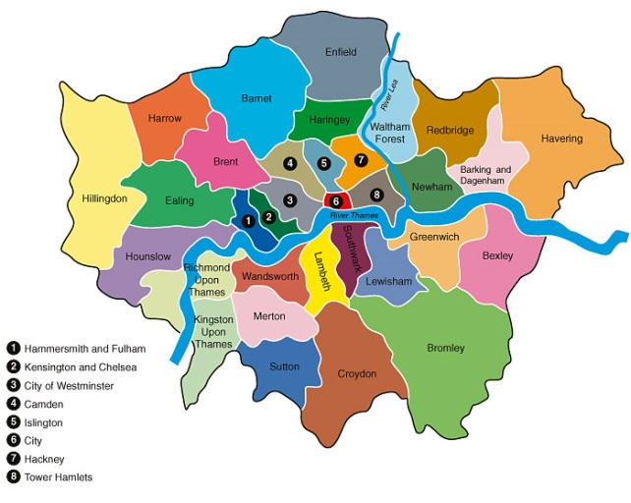
What happens next?
Co-ordinated admissions
all 33 London boroughs and surrounding county councils are included in the co-ordinated admissions process
application lists are exchanged
offer lists are drawn up
offer lists are exchanged

Slide 26
What happens next?
How will places be allocated?
If the school receives more applications than places available, the published admissions criteria will be applied to decide who can be offered a place
each school listed on the application form is equally considered against the school’s admissions criteria regardless of the preference order
your ranking order is not passed on to the individual schools.

Slide 27
Offers
Will I be offered more than one school place?
All children will be offered one school place
if your child qualifies for more than one school place, you will be offered the school which you ranked higher on your application form
any school ranked lower than the one you have been offered will automatically be withdrawn and offered to another child.

Slide 28
Offers
Are there enough school places available?
Yes
The Local Authority makes annual plans to ensure there are enough school places for every Barnet applicant
every child will be provided with a school place
however, it may not always be possible to offer a preference school.

Slide 29
Offers
National Offer Day is
Monday 3 March 2025
You will receive an email with the outcome of your application during the evening of 3 March
You can then login into your eAdmissions account for further information

Slide 30
Offers
Accepting offers
Places must be accepted or declined online by Monday 17 March 2025

Slide 31
No Preference Offer?
What happens if I don’t get any of my preferred schools?
Their name will remain on the waiting lists for your selected schools
You will have the right to appeal
Your child’s name can be added to additional school waiting lists
Your child will be allocated a place at school with a vacancy

Slide 32
Appeals
Every parent has the right of appeal
Appeals are heard by an independent panel
You will have the opportunity to present your case in person
You will need to convince the panel that your child’s needs are more important than the school’s need to limit the admission number
Appeals are unlikely to be successful unless there are exceptional grounds

Slide 33
The Archer Academy
child in care (LAC, Post LAC), children of founders, siblings, children of staff
Priority postcodes N2 (45%) N3 (35%) NW11 (20%)
Distance within those postcodes from Stanley Rd entrance
(0.255 (N2) 0.922 (N3) 1.062 (NW11) 2023
(0.223 (N2) 1.295 (N3) 1.038 (NW11) 2024
162 places
No priority places for specific primary schools

Slide 34
Christ College Academy
Has been co-ed from 2018. Intake for 2018 and 2019 was around 1/3 girls. 2024 close to 50:50
Catchment distance (1.39 miles 2024, 1.109 2023, 1.1 miles 2022, 2.4 miles 2021, 2.6 miles 2020, 3.5 miles 2019, 4.1 miles 2018, 7.3 miles 2017) distance from main building
Criteria: child in care (LAC, Post LAC), Siblings, children of staff, distance from school
172 places

Slide 35
Fee Paying Schools
Nearly all selected by academic ability but a range of levels and criteria.
Bursaries/ scholarships are available. Different amounts and criteria- see individual schools.
Offers are usually made and deposits required prior to state school offers being made.
Some tutoring is recommended for familiarity with papers or a weaker subject. Be wary of excessive tutoring.

Slide 36
Fee Paying Schools
Are consortia of schools who coordinate their entry tests but have to pay to apply to each school in the consortium.
Don’t apply to too many. Visit and prioritise.
Schools will request a reference from us in Autumn Term. Class teacher and HT will write these. We will ask you to help us with info about out of school interests.
Have a state school back up plan. Family circumstances can change sometimes suddenly.

Slide 37
Transfer to Secondary School September 2025

