Slide 1
Anger and Anxiety in Boys

Slide 2
Agenda
What is anger?
Consequences
Understanding the underlying causes
Relationship Building
Self-Regulation and Self Care
Prevention
Responsive Strategies

Slide 3
What is anger?
Anger is a natural human emotion that arises often as a response to a perceived threats, injustices , or frustrations.
It can range from mild irritation to intense rage and, when not managed effectively, may manifest in aggressive behaviours that impact learning, relationships, and wellbeing-both for the individual and those around.
Notes:
Anger is a natural human emotion that arises often as a response to a perceived threats, injustices , or frustrations. It can range from mild irritation to intense range and, when not managed effectively, may manifest in aggressive behaviours that impact learning, relationships, and wellbeing-both for the individual and those around.
This session aims to provide teachers an insight into how anger and aggression can present in boys, particularly within a school setting. Research indicates that boys may express emotional distress through externalised behaviour more frequently than girls, often due to societal expectations, developmental differences or unrecognised emotional needs.
This training aims to help in understanding underlying causes of anger, and develop effective trauma informed strategies for support and de-escalation

Slide 4
Consequences
When a boy displays anger through disruptive or aggressive behaviour it is natural for the adults around them to respond with consequences.
Clear boundaries and accountability are essential, however, it is equally important to recognise that consequence without understanding can miss valuable opportunities for emotional growth.
Anger often masks other feelings such as fear or shame.
Rather than just responding with discipline you can also give space for conversation.
Notes:
Encouraging teachers to talk to students about the way they express their anger
When a boy displays anger through disruptive or aggressive behaviour it is natural for schools to respond with consequences.
Clear boundaries and accountability are essential, however, it is equally important to recognise that punishment without understanding its root can miss valuable opportunities for emotional growth.
Anger often masks other feelings such as fear or shame.
Rather than just responding with discipline you can also give space for conversation.
Give time to cool down
Use calm open ended questions "How were you feeling before that happened"
Validate emotions
Teach emotional vocabulary
Offering regular check in or reflective time with a trusted adult
If you can identify when a student starts to feel angry/ is experiencing some of the emotions below the tip of the iceberg, how can you encourage them at this point to start expressing these feelings before they “explode”. By combining appropriate consequences with supportive conversations, teachers can help boys move beyond impulsive reactions and toward a more constructive, self-aware response. Tis help sbuild emotional literacy that lasts far beyond the classroom.
What are the challenges when trying to relate to a child/ keep an eye on all students?

Slide 5
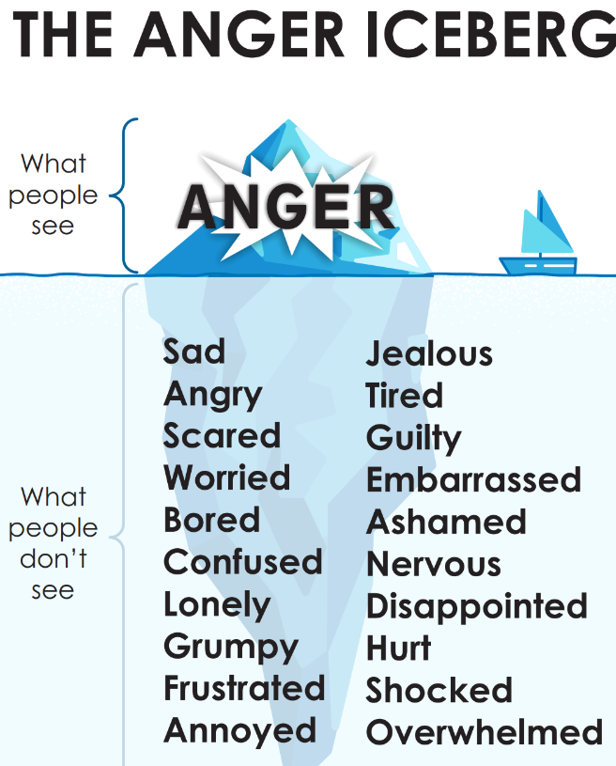
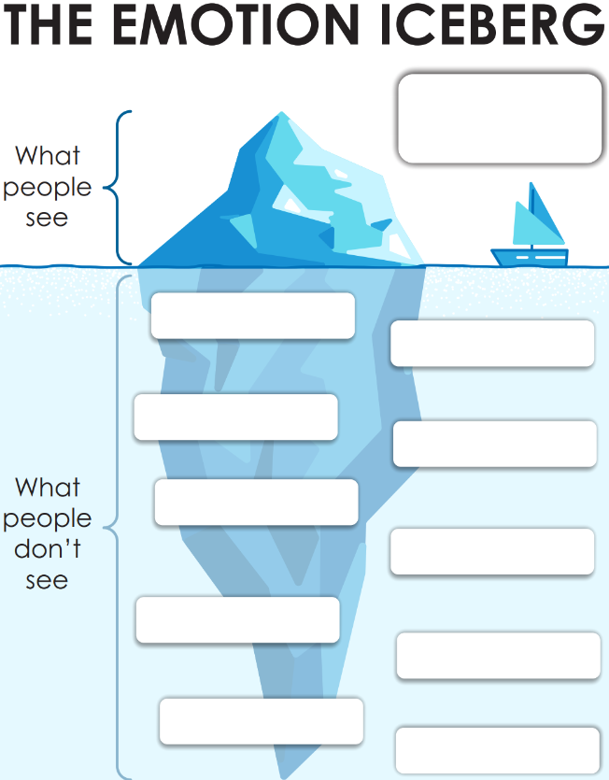

Slide 6
Understanding Anger in Boys - Beyond Behaviour
Developmental & Societal Influences
  Boys often socialised to suppress vulnerability
  Anger as a more "acceptable" emotional outlet. (Pollack, 1998)
  Delays in developing emotional regulation and verbal expression in childhood.
Trauma and socioeconomic factors
  Exposure to instability neglect or violence can influence on expressions of emotions and lead to more behaviour that is seen as aggressive due to impact on emotional regulation (Perry & Szalavitz, 2017)
Which boys are we more likely to view as aggressive?
  Adultification – viewing children and young people as older and less innocent. This is often down to marginalised or racialised young people. (Davis & Marsh, 2020)
  Racial and class-based biases (Gillborn, 2008)
Not all anger is misbehaviour it may also be a message of greater need.
Notes:
Let's take a deeper look at why boys may more frequently express anger or aggression in school settings-and why it's crucial that we move beyond surface level reactions to challenging behaviour.
Developmental & Societal Influences
Boys often socialised to suppress vulnerability
Anger as a more "acceptable" emotional outlet.
How societal views of masculinity might be contributing to this (toxic masculinity) - think Adolescence, boys encouraged to man up
Trauma and socioeconomic factors
Exposure to instability neglect or violence can influence on expressions of emotions and lead to more behaviour that is seen as aggressive.
Children exposed to chronic stress, poverty , violence or unstable home environments may develop heightened stress responses. This puts them in a state of constant alertness-reacting with anger when they feel threatened or unsafe even in seemingly neutral classroom.
Which boys are we more likely to view as aggressive?
Adultification
Racial and class-based biases.
Boys from ethnic minority backgrounds particularly Black boys are disproportionately labelled as aggressive or defiant. This isn't because they are angrier, but because society is quicker to pathologise their behaviour. These biases can lead to exclusion, punishment and further marginalisation reinforcinf cycles of mistrust and disengagement.
Having a trauma-informed lens in how we talk about aggression
How teachers would perceive children as being angry, not all anger is misbehaviour is may also be a message of greater need.
Adultification means treating children or young people as if they are older, more grown‑up, and less innocent than they really are. Instead of seeing them as children who need care, understanding, and protection, adults may expect them to behave like adults or blame them more harshly for mistakes.
This often happens to marginalised or racialised young people. For example, some children from minoritised ethnic backgrounds may be seen as “troublemakers,” “aggressive,” or “streetwise,” even when their behaviour is normal for their age. Because of this, they may be punished more, supported less, or not believed when they need help.
Racial and class-based biases are the unfair beliefs or assumptions people hold based on a child’s race or social class. These biases can lead adults (such as teachers, professionals, or police) to judge children differently. For example, a child from a poorer background or a racialised group might be seen as badly behaved, while the same behaviour from a more privileged child is seen as “just a phase.”

Slide 7
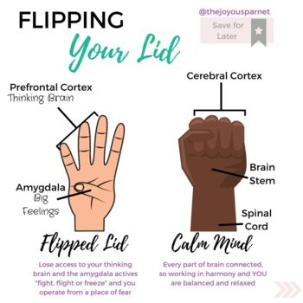
Psychoeducation This is a really good quality video explaining this concept. https://www.youtube.com/watch?v=qFTljLo1bK8&t=17s
Two key brain areas help manage emotions
  Amygdala → reacts to strong emotions and perceived danger
  Prefrontal cortex → planning, thinking, decision making → isn’t fully developed until aged 25
When we feel calm, the prefrontal cortex stays in charge.
When we feel threatened or overwhelmed, the amygdala takes over.
The amygdala sends signals to react quickly—sometimes before we’ve had a chance to think.
This can lead to saying or doing things we later regret.
With practice, we can recognise the signs and create a pause before reacting.
Notes:
Just read here: Let’s take a moment to think about what’s going on in a young person’s brain when they feel anger rising. You’ve probably heard of the amygdala—it’s like the brain’s smoke alarm. It’s there to keep us safe, reacting instantly when we sense danger. On the other hand, the prefrontal cortex is the part that helps us make thoughtful decisions.
But when a student is triggered—by stress, fear, or even embarrassment—the amygdala can override everything, including that more rational prefrontal cortex. That’s why some kids lash out or shut down so quickly—it’s not that they won’t think, it’s that they can’t in that moment.
The good news is that over time, with support, students can learn to spot those warning signs earlier and begin to slow things down. This is where your role becomes so powerful—because you can help them create that pause

Slide 8

Spotting the Signs of Anger in Young People
Reflective Questions:
How do you usually tell when your child is beginning to feel angry?
What signs—verbal, physical, or emotional—do you look for?
Are there patterns? (e.g. time of day, after a specific activity)
How do you respond in the moment?
Are there any situations where you’ve reflected and thought, “I could have handled that differently?”
How can we manage our own responses when we notice a child showing early signs?
Notes:
Let’s open this up to discussion now. Think about your students. Can you usually tell when one of them is beginning to feel angry, even before anything is said? What are the cues you notice? Maybe it's in their body language, or the way they enter the room.
Also think about patterns: does it happen at a certain time, or with specific triggers? And what’s your response in that moment? This part is so important, because often, our reaction can either help to de-escalate… or unintentionally fuel the fire.
Let’s talk about what we notice and how we might shift our approach when we see those early warning signs
Feel free to either call out or put your responses in the chat

Slide 9
Importance of positive relationships
Relationships are protective
  A trusted adult can buffer the effects of stress and help regulate emotions.
Connection before correction
  When a young person feels understood, they’re more open to guidance and boundaries.
Emotional safety supports learning
  Positive relationships help create a calm internal state.
Consistency and reliability
  Even small, predictable interactions (e.g. noticing changes in mood) can make a big impact over time.
Mentalisation
  Understanding what a child might be thinking or feeling helps us respond with empathy rather than reactivity.
Repair is key
  All relationships have ruptures. Taking time to acknowledge and repair helps rebuild trust and models emotional resilience.
Notes:
When a young person feels safe with an adult, their stress response calms down faster. In fact, the relationship itself becomes a protective factor, something that literally helps regulate their nervous system. You might have heard of the phrase ”connection before correction.”
Sometimes the small, consistent actions, such as using a warm tone, or simply noticing how they’re doing, are what build the trust that leads to long-term change.
And it’s not about getting it right all the time. Any relationship can have a rupture. It’s important to demonstrate and model how to repair that rupture. Showing a young person that you're willing to come back, acknowledge things, and repair, that’s what builds true emotional safety.
For many students, these positive relationships might be the first time that an adult has demonstrated how to repair a relationship.
Let’s take a moment now to think together:
What are the relationship systems or routines that are already working in your school? (e.g. tutor groups or trusted adult allocations)
Are there any things you would like to implement in your school?

Slide 10
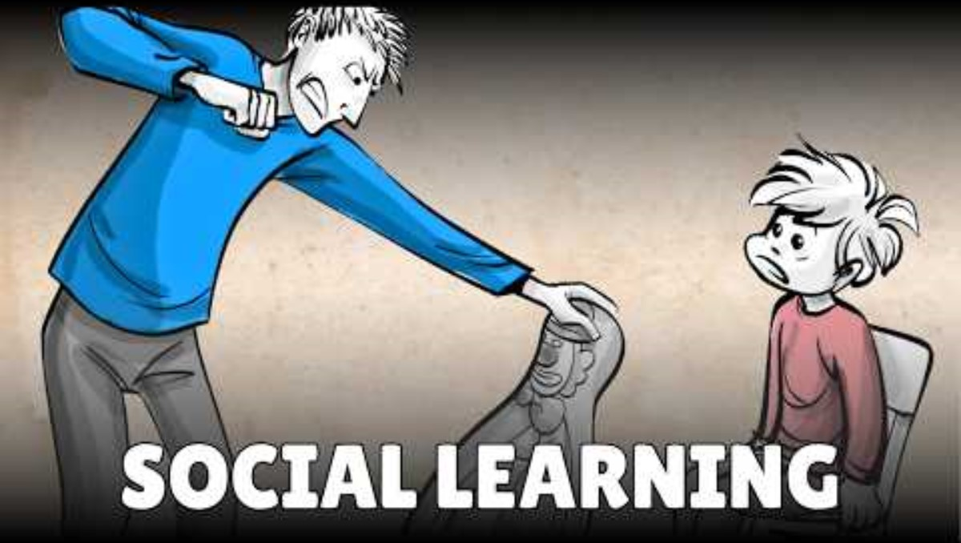
Being good role models - Social Learning Theory
Bandura's Bobo Doll (0:33-1:34)
Social Learning Theory: Bandura’s Bobo Beatdown Experiments
Children learn behaviours from the people around them, especially those they see as authoritative figures
Notes:
To prevent aggressive behaviour from young people, school adults must first set a good example. I know this sounds obvious, but the effect of adult modelling really shows in the Bobo doll experiment. Albert Bandura conducted an experiment in the 60s to support his social learning theory, where he hypothesised that humans learn behaviour by observing others. The following video will explain it better than I can.
So as the video showed, children can learn aggressive behaviour from the adults around them, and as students will spend a lot of time around school adults, they will likely model their behaviour after teachers/ TAs and other school staff. If an incident arises, and school adults respond with or even escalate with strong emotions at school, students will learn to react in the same way. Similarly, as you already do so in lessons, modelling positive reactions to difficult situations can teach valuable problem solving skills to your students. While our control over how other adults in their lives act, what you can do as school staff is to regulate your own emotions, such that you are modelling positive behaviour for the young people in your schools.

Slide 11
Creating Spaces for Children to Talk
Strike while the iron is cold
  Children will likely be unable to express how they feel when dysregulated, find a time when they are calm to revisit specific incidents
Young person to take the lead
  Communicate clearly with the young person that this is their space to express their feelings during a difficult episode and that no one will interrupt them for a certain amount of time ~10 mins
  Adults to not ask questions or give suggestions at this point, as they may want to feel heard and not judged
Ending this space
  After the designated time period/a considerable amount of silence, ask if they would like more time to talk
  Ask if they would like some time to regulate/ if they'd like to you to provide support
Notes:
When we work with younger children, in primary school, who are showing what we call challenging behaviour, one of the first techniques we teach parents is called special time, which is a designated period of time where parents will play with their child, but the child is in charge of play and takes the lead, whereas the parent plays a more passive and more of a "follower" role. This faciliates strong bonding between the parent and the child and builds the foundation to decrease challenging behaviour. We can use the same principles here to work with older students in Secondary school. Often students are reprimanded for showing aggressive behaviour and feel like they do not have a space to express their emotions and thoughts, which can lead to further episodes of aggression.
Here we have a guide on how to create a safe space for students to talk.

Slide 12
Creating Spaces to Talk
Troubleshooting
Be comfortable with silence!
Repeat after the child
  Checking understanding
  Shows that although you are not leading the conversation, you are still engaged
Giving suggestions
  Normalise, "I often feel like this.... when I'm angry"; "things like …. make me feel upset"; "One time, I acted out like... because of..."
  Phrase suggestions as questions after normalising statement, "… is that similar to what happened?", "is that similar to how you felt?"
If a child becomes dysregulated during this conversation, regulate using breathing and grounding techniques
Notes:
In my experience working with young people, the most common response I get is "I don't know", and when you're providing this space for a student to express himself, he might not want to chat, or doesn’t know how to express his thoughts or feelings. So here are some tips on what to do if you feel like the talking space isn't used effectively.
It might sound counter-intuitive, but the first step is to be comfortable with silence...
If a young person becomes quiet after a period of talking. You could repeat what he says, "so this happened, and it made you feel like this. Did I get that right?" This does two things, it allows you to check your understanding of what the young person has said, and it gives him a chance to build on what he said previously, or to correct you if you're wrong. It also shows the student that although you are not leading the conversation, you are still engaged in what he is saying.
If the young person is struggling to express their thoughts and emotions, then you may give some suggestions to facilitate conversation. Start by asking for consent "I know this is your space to talk about you, but I see that you're struggling a bit with that, is it okay if I give some suggestions and see if you agree with any of these things? To suggest, you should start off by normalising his experiences, and you can do this by bringing in your own experiences, or even make up a story (the student doesn’t have to know its made-up). Start off by saying, I often feel like... when I'm angry, or this happened once, and it made me feel very upset, or one time, I acted like this so and so, because I was feeling so and so. This allows them to realise that other people may also have similar experience that they can relate to, and they may become more likely to open up. The suggestion then follows the normalising statement, you can use phrases like is that similar to what happened, or is that similar to how you felt? Does my story apply to you etc.
A child may become dysregulated while talking about difficult situations, so please recommend breathing and grounding techniques as appropriate.

Slide 13
Preventative - Positive self-talk
What is self-talk?
The internal voice we all have (what we say to ourselves in our minds)
Negative self-talk can fuel anxiety, anger, and low self-esteem.
Positive self-talk helps regulate emotions, build confidence, and reduce overreactions.
How adults can support:
Model positive self-talk out loud.
Prompt children with alternative ways of thinking.
Reinforce effort, not just outcome.
Notes:
This slide introduces a key preventative tool: positive self-talk. Everyone has an internal voice in their head narrating what’s happening. For some boys, especially those who struggle with emotional expression, that inner voice can be harsh, self-critical, or even catastrophising.
Over time, this kind of thinking can fuel anxiety, frustration, or shutdowns. But we can help them reshape that voice into something more supportive and realistic.
You might hear a student say, 'I’m rubbish at this' or 'Everyone hates me.' When we catch those moments and gently challenge them: 'You’re still learning' or 'That’s a big assumption; what else could be true?’. It supports them in beginning to to think differently.
When we model positive self-talk ourselves, we show them what it sounds like to be kind to yourself. Saying things like, 'That didn’t go to plan, but I know what to do next time,' gives students permission to be human and to keep trying.

Slide 14
Common negative self-talk in young people:
“I always mess things up.”
“Everyone’s laughing at me.”
“There’s no point in trying.”
Helpful alternatives:
“I made a mistake, but I can try again.”
“People might not be thinking what I think they are.”
“This is hard, but I’ve done hard things before.”

Slide 15
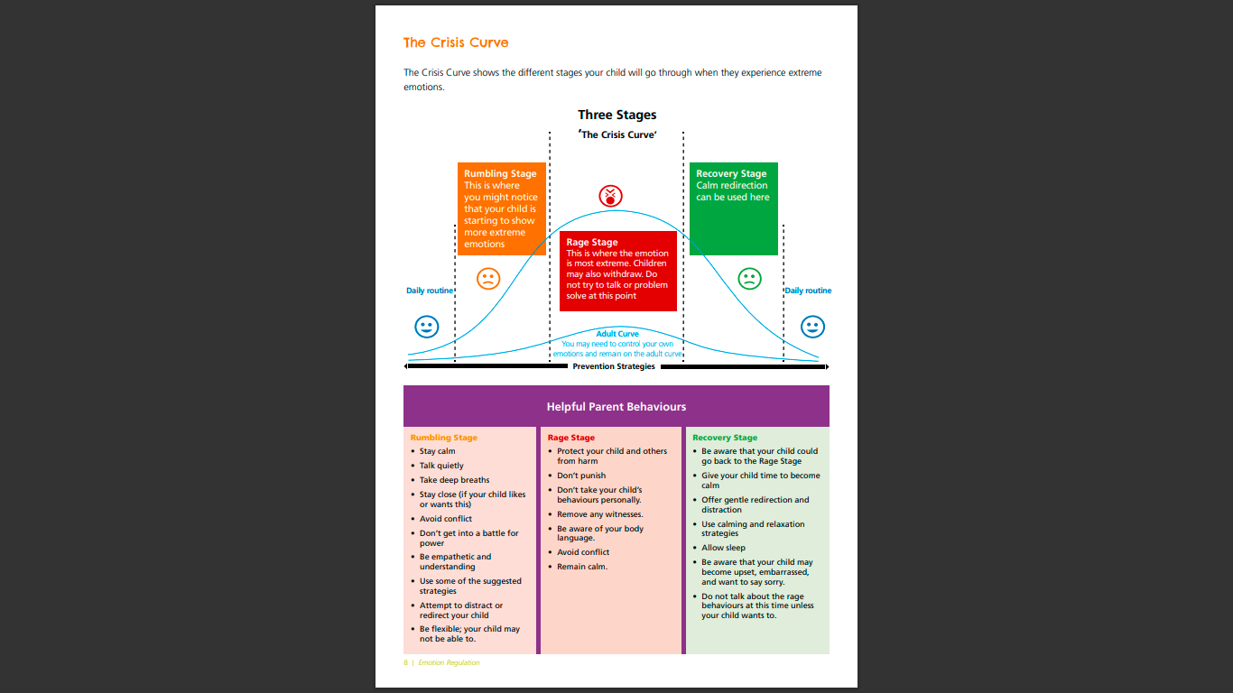
Strategy - Emotional regulation – crisis curve.
Notes:
When considering a strategy it will be important to consider the stages of anger a child may go through to ensure the best outcome.
The rumbling stage is when you see that a child is becoming upset, this is where you can
Distract,
Deescalate
Gently prompt to partake in grounding activity.
Change environmental factors triggering anger.
In the rage stage – as you can see most of the suggestions are to do not do. This is that when a child in this stage they will be in their emotional side of their brain (from the hand model of the brain), it is very hard to rationalise.
Think about as adults something gets us angry its hard to listen to our friends suggestions.
The same for a child.
In this moment, it maybe to gently guide the child to a calm space.
Have some things items they are allowed to let anger out on until calm.
Regulating own emotions also can help lower this stage.
The recovery stage is equally important – Is their room for repair, planning on how to support the child if this situation to reoccur. Is there anything in the environment that can be changed.
Any strategies that may be helpful for this child, conflict resolution, relationship building.
The key is to not consequence for feeling angry and to find a reasonable consequence or strategy.
Example before giving a detention, can they be given a change to implement a plan to help them prevent this next time.

Slide 16
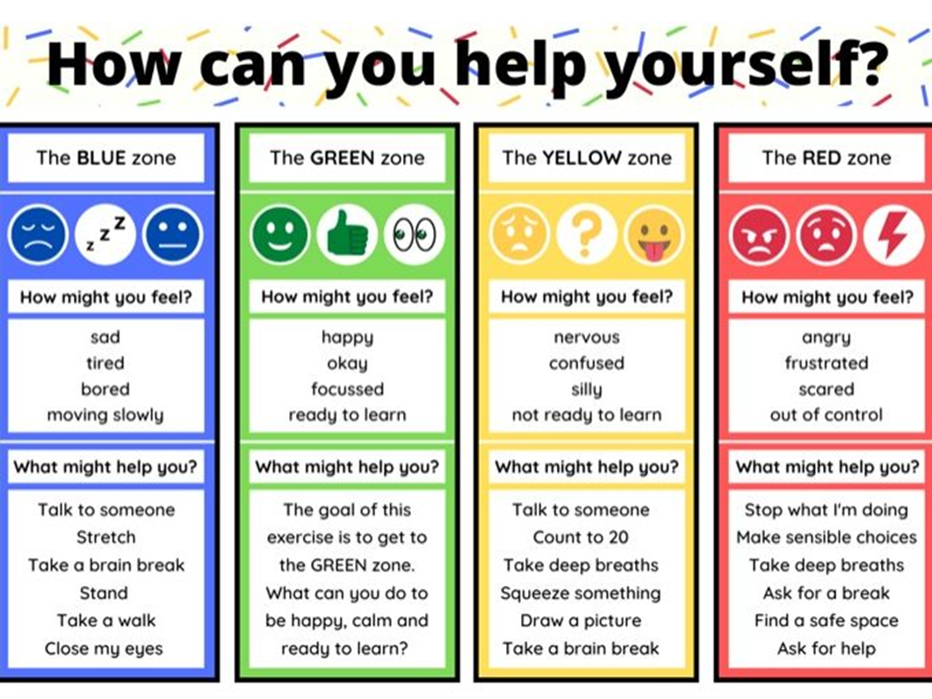
Strategy Zones of regulation
Notes:
The zones of regulation could also be helpful for a child to communicate their mood and communicate what they may need in the moment.
Some schools have do not always use this model but they implement this without using it – for example they have a way to express how they feel in a non verbal way.
There are the different levels and anger there may be different approaches to how to respond.
Have you got any examples where this has helped a child experiencing anger?

Slide 17
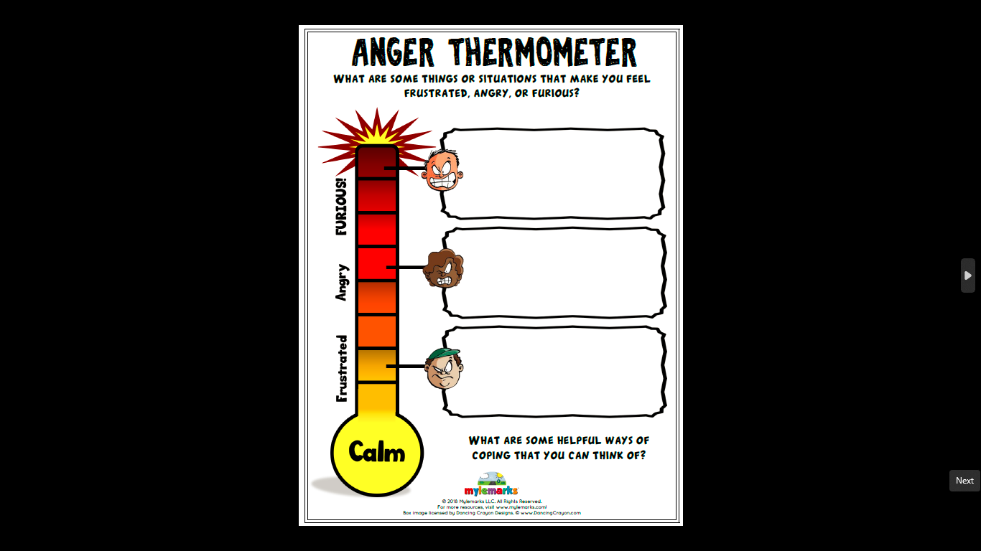
Adapting strategies
Notes:
ES- An example activity with a child/young person – you can ask them to name situations /triggers which result in different levels of anger
They frustrated and angry stages- Will be where you suggest the preventative approach as relevant.
Then furious – may be strategies, like walking away or TIPP ( temperature, exercise , Pressure). Perhaps what they need from others in these stages.
As an addition to this you can introduced a red or yellow card where the young person show you which level they are at therefore you know how to respond based on the pre agreed plan.
For older young people is their a secret word or signal they can tell professionals they are feeling overwhelmed.
What strategies or approaches have worked for you for high levels of anger?

Slide 18
Case Study – Problem Solving?
Case
Raj was a young man of fifteen years old. He has had difficulties with managing his angers since starting secondary school. His difficulties have become worse since starting year 10. He has recently been suspended for getting into a physical fight with a classmate. This other classmate is also known to get into fights also.
A group of boys make comment on Raj's outfit. Raj starts to shout and threaten them. Raj's head of year comes in telling them off and to stop arguing. Raj gets more angry hits out at the other students and barges past the head of year.
Raj runs off to the student wellbeing room, he is pacing back and forth and crying.
Questions – How would you try, and problem solve supporting RAJ?
What further questions do you have about Raj?
How could Raj have dealt with this different?
How do you think the head of year could have responded differently?
What would you do if you see Raj pacing up and down the room?

Slide 19
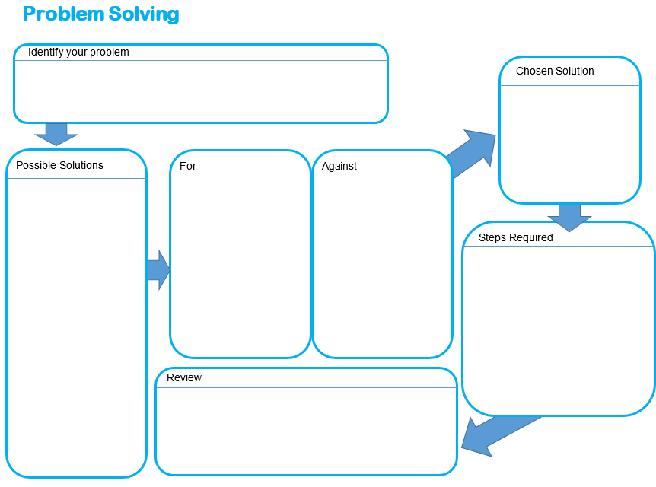
Problem solving
Notes:
Stop and take a breather. Say the problem out loud
Think about possible solutions
Express
Possible solutions

Slide 20
What you can do in the moment
Stay calm and grounded yourself
Your tone, body language, and pace can help de-escalate the situation.
Give space, not silence
Step back if needed, but reassure them: “I’m here when you’re ready.”
Use short, clear instructions
Avoid long explanations—focus on safety and clarity.
e.g. “Let’s step outside for a breather.”
Name what you see (not how they feel)
Say what’s observable, without judgement:
“I can see you’re clenching your fists.”
Avoid ‘why’ questions in the heat of the moment
These can feel blaming or provoke more anger.
Offer regulation tools if appropriate
Breathing exercises, movement breaks, or a quiet space only if the student is receptive.
Defer the conversation until calm returns
Focus first on helping the young person feel safe and regulated.
Notes:
This slide focuses on de-escalation: what adults can realistically do when a young person is angry or overwhelmed. One of the most important things to remember is that you can’t reason with a dysregulated brain (hand model of the brain reference). The goal in the moment isn’t to solve the problem or discipline, it’s to help the student regain a sense of control and safety.
The way you show up matters. A calm adult nervous system can help settle an activated young person. Keeping your voice low, using fewer words, and offering space without making them feel abandoned can really shift the tone.
Avoid ‘why’ questions like 'Why did you do that?' or 'What’s wrong with you?’ these rarely land well in the heat of the moment. Instead, try grounding statements like 'Let’s take a minute' or 'I’m going to stay nearby.'
We want to signal safety, not threat. Once the young person is calm, that’s when the conversation can happen.
This links back to the slide of what you can do to help regulate yourself.

Slide 21
Signposting
Barnet Boys' Brigade and Girls' Association (for younger children aged 8-10)
https://www.youngminds.org.uk/young-person/my-feelings/anger/
https://www.youngminds.org.uk/professional/resources/when-emotions-explode/
https://boysinmind.co.uk/
https://solutions.brighthorizons.co.uk/resourceroom/teen-parenting-blogs/mental-health-issues-in-teen-boys
https://www.mentalhealth.org.uk/explore-mental-health/blogs/boys-men-and-mental-health
Notes:
4pm es

