Slide 1
Understanding and Managing Anxiety
BICS
Notes:
HK
Hello everyone, welcome to today's coffee morning.
Our names are -
Today we will be talking about anxiety. [Next slide – aims]

Slide 2
Aims for today
To help you understand what anxiety is and what it looks like in children
To briefly introduce ways of managing anxiety in children
Notes:
HK

Slide 3

What is Anxiety?
Anxiety is what we feel when we are worried, tense or afraid.
Anxiety is our natural alarm system, which goes off when we perceive that we are under threat.
Sometimes the alarm system is faulty - it goes off when it shouldn’t. This can cause a lot of problems.
It's particularly common to experience some anxiety while coping with stressful events or changes, especially if they could have a big impact on your life.
Notes:
KE

Slide 4

What does anxiety affect?
Anxiety affects our thoughts, emotions, behaviours, and bodily sensations.
Anxiety can be impacted by changing our behaviours.
Anxiety can be reduced by challenging our thoughts.
Notes:
KE
Anxiety can affect our thoughts, emotions, behaviours, and bodily sensations.
Physical health: anxiety in children can manifest physically, with symptoms likes increased heart rate, muscle tension, headaches, stomach-aches, fatigue, and disruptions in sleep patterns.
Emotional wellbeing: children with anxiety may experience heightened emotional responses, including feelings of fear, worry, irritability, restlessness. Anxiety can influence a child’s mood and emotional regulation, leading to increased emotional distress.
Cognitive functioning: anxiety can affect a child’s cognitive abilities, such as concentration, memory, decision-making, and problem-solving. Anxious thoughts may intrude, making it challenging for children to focus on schoolwork or daily tasks.
Behavioural patterns: anxiety can influence a child’s behaviour, leading to avoidance of certain activities or situations perceived as stressful. Some children may develop rituals or repetitive behaviours as coping mechanisms.
Anxiety can be impacted by changing our behaviours: for children maintaining consistent routines provides a sense of security, such as regular bedtime, mealtime. Playful activities not only promote physical wellbeing but also contribute to emotional regulation. Mindfulness exercises such as breathing exercises can be helpful.
Children can be supported in a supportive and controlled manner, to face their fears in small behavioural experiments to challenge their anxious thoughts.
Anxiety can be reduced by challenging our thoughts: helping children recognize and label their negative or anxious thoughts, using age-appropriate language to discuss feelings and thoughts.
Encouraging children to question the accuracy of their thoughts by gently asking them to consider whether their worries are based on real evidence or if they might be imagining things.
Helping the children engage in reality testing by asking questions like “have similar things happened before without any problem?”
Do any of these behavioural effects sound familiar to anyone? What anxious behaviours do people notice in their children?

Slide 5
How is Anxiety Developed?
No single factor is likely to have caused your child’s anxiety disorder.
Typically, a number of factors play a role:
Biological Factors:
1/3 of what makes us anxious can be explained by genes. We may inherit characteristics i.e. sensitivity.
Learning by Example:
We can pick up fears from our parents or others around us.
Adverse Life Events:
Stressful events may have more impact on children.
Social Environment:
How others respond to the child when they are anxious. For example, parents may inadvertently encourage their child to avoid situations they fear.
Notes:
TC
Biological factors: 1/3 of what makes us anxious can be explained by genes. Children with a family history of anxiety disorders may be more predisposed to developing anxiety themselves. We may inherit particular characteristics, ex: sensitivity.
Learning by example: children can pick up fears from others around them. They can learn anxious behaviours by observing how their parents respond to stress and anxiety. Modelling anxious behaviours can contribute to the development of similar patterns in the child.
Adverse life events: stressful events may have more impact on children,
Social environment: how others respond to the child when they are anxious. For example, parents may inadvertently encourage their child to avoid situations they fear.

Slide 6
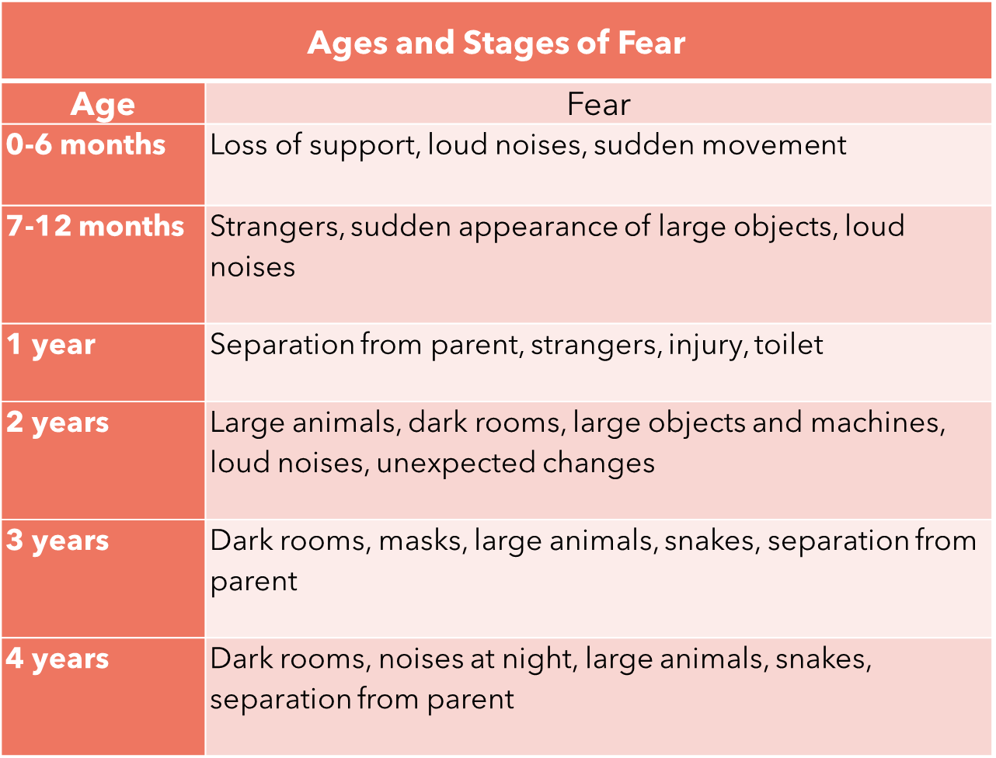
Notes:
TC
Young children often have fears related to separation, darkness, or imaginary creatures. It’s a way for them to make sense of the world.
As children grow, fears might shift to more social aspects, like fear of failure, making mistakes, or not fitting in.
In adolescence, fears can become more complex, involving academic pressures, social relationships and concerns about the future.
Infancy (0-12 months)
Fear at this stage is often related to loud noises, sudden movements, or being separated from caregivers.
Toddlerhood (1-3years)
Common fear includes separation anxiety, fear of the dark, or fear of new people or situations.
Preschool (4-6 years)
Imaginary fears, like monsters or ghosts may emerge. Social
Typical examples – everyone is unique, won’t be the same for all of your children… old reference – fears now may be more related to gangs, covid… gaming, etc

Slide 7
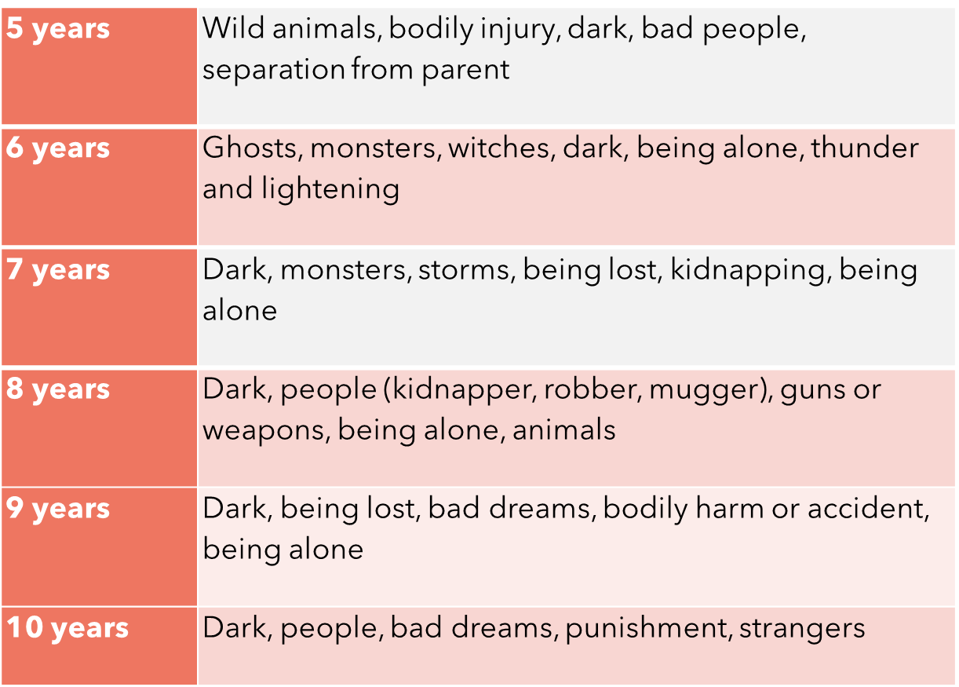
Notes:
TC
Early school years (7-9 years old)
Fears may shift to performance-related anxieties, like fear of social rejection.
Pre-adolescence (10-12 years)
Anxiety related to body changes, social acceptance and academic expectations may intensify.
Fear of something happening to parents / family – they start to have an awareness of outside of themselves; that things happen outside of their world and control.
Start to have an awareness of death; that it happens and that it is permanent and outside of their control.

Slide 8
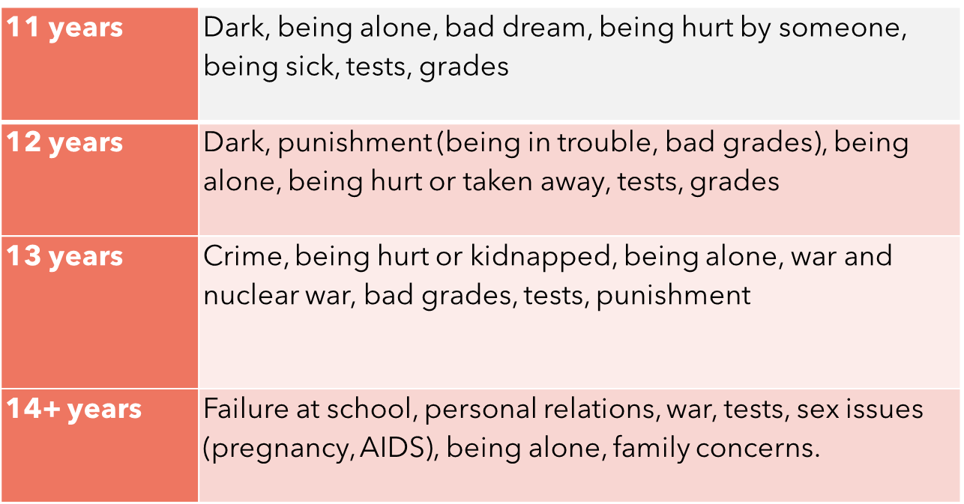
Source: Robinson III, E., & Rotter, J. (1991). Children’s fears: Toward a preventative model. School Counselor, 38(3), 187.
Notes:
TC
Early adolescence (13-15)
Fears related to anxiety, peer pressure and academic stress become more prominent. Anxiety about body image.

Slide 9
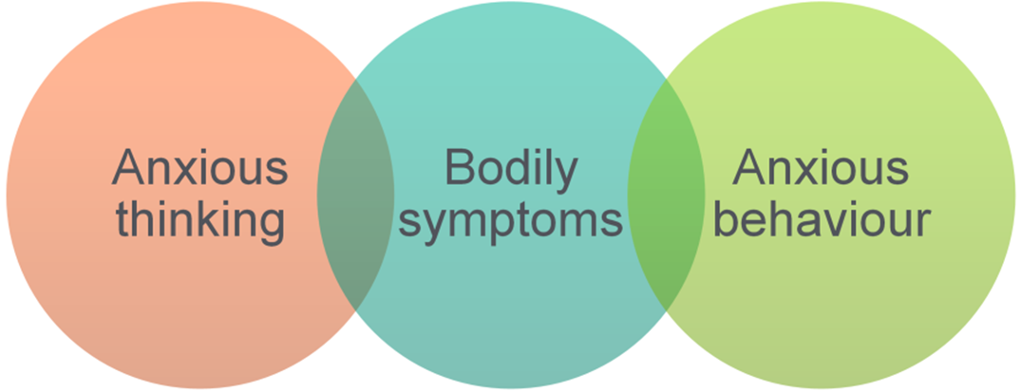
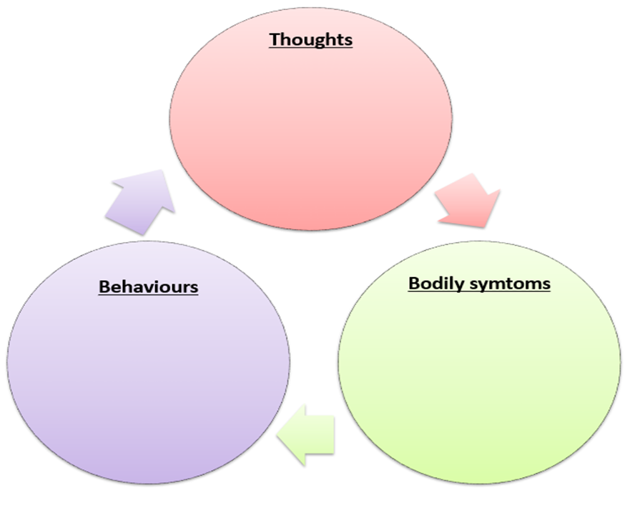
What keeps anxiety going?
Notes:
KE
Briefly describe the ways in which anxiety can impact on a child’s life:
social life (problems with friendships)
academic performance (reduced academic achievement)
mood (more likely to become depressed).
Discussion point: Ask parents to reflect upon the biggest problems caused by anxiety and to write this down. Ask them to consider if there are other ways in which anxiety impacts their life which haven’t been raised so far. Ask if anyone is willing to share his or her child’s experiences with the group.
Children may engage in negative self-talk, express worries about various aspects of their life, or anticipate negative outcomes – negative thought patterns contribute to heightened anxiety by magnifying perceived threats and fostering excessive worry in children.
Children may exhibit physical symptoms of anxiety, such as stomach-ache’s, headaches or restlessness. These physical symptoms can be misinterpreted by children as evidence of a real threat, reinforcing their belief that the feared situation is dangerous.
Children may avoid certain activities, places or social situations that trigger anxiety – avoidance may prevent children from learning that they can face and cope with challenging situations. Over time, it reinforces the idea hat the feared situations are genuinely threatening.
Anxious children may withdraw from social activities, avoiding peers, group activities, or events. Fear of judgement or criticism can lead to isolation.
Anxiety may hinder a child’s ability to initiate and maintain friendships.
Anxious children may resist trying new things or participating in unfamiliar situations, limiting their exposure to social and developmental opportunities.
Persistent anxiety can strain relationships with friends, as the child may struggle with trust, communication and maintaining connections.
Anxiety can lead to difficulty concentrating and focusing on academic tasks. Children may be preoccupied with worries, making it challenging to engage in learning.
Anxiety often manifests as irritability, and children may become easily frustrated, agitated, or have mood swings.
Anxiety can contribute to feelings of sadness and tearfulness, especially when the child feels overwhelmed of helpless.

Slide 10
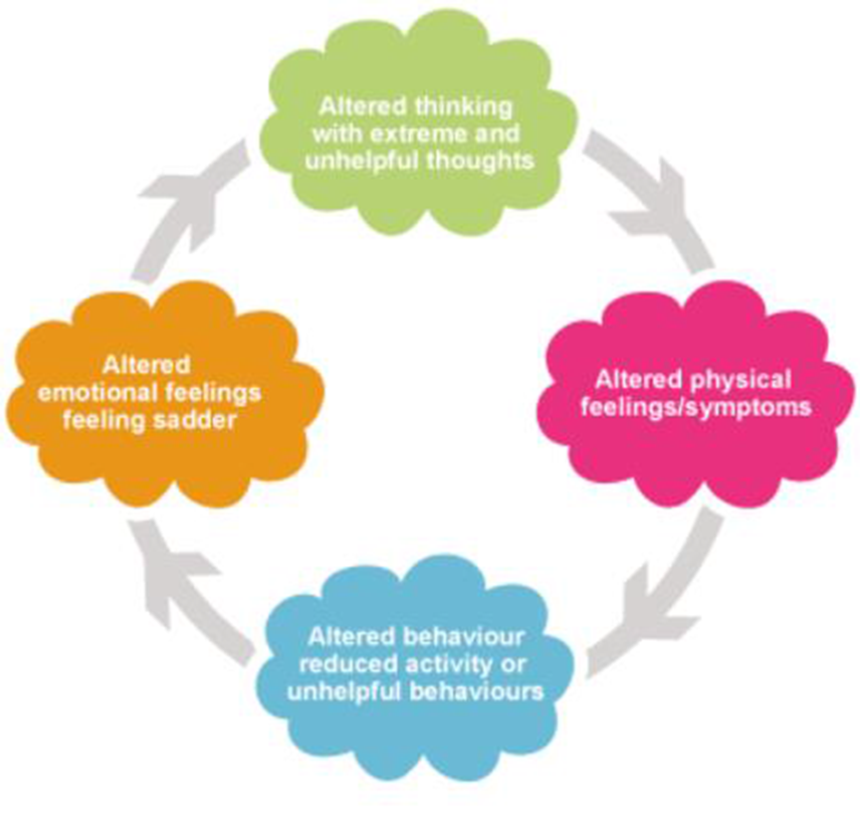
Vicious Cycle of Anxiety
When people are experiencing Anxiety they:
Overestimate the danger and
Underestimate their ability to cope.
We can look at the vicious cycle of anxiety and make changes to try and break it.
Notes:
KE
Do you have a good idea of what your child’s anxious thoughts are when they are in a challenging situation?
Has there been a time when their fear wasn’t what you expected?

Slide 11
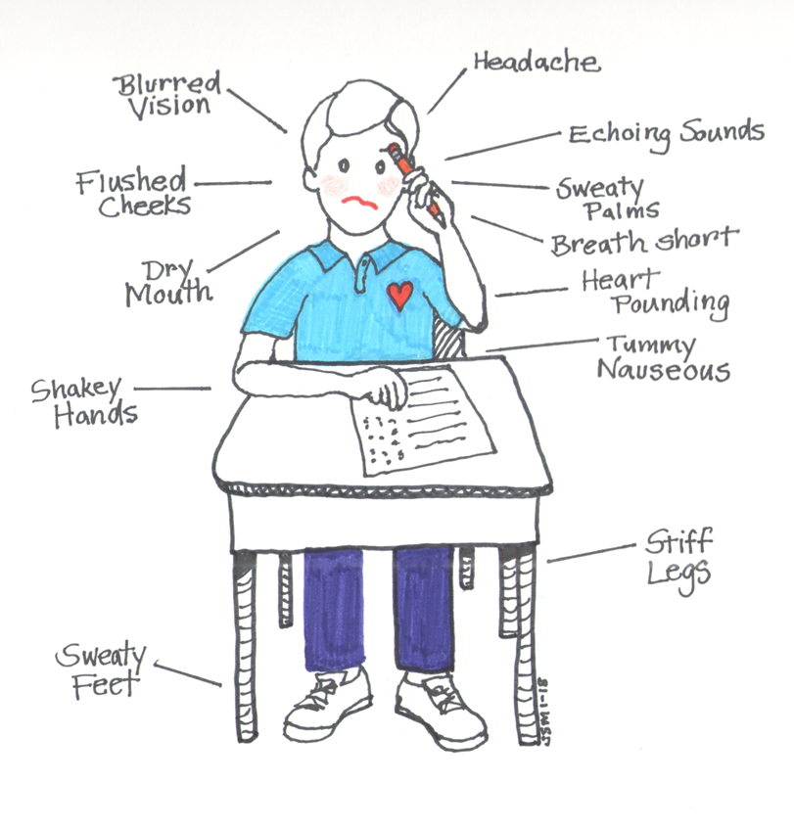
Bodily Response to Anxiety
Child interprets these as a sign that something bad it happening
Being aware of physical symptoms reduces confidence in coping with challenges
Can be unpleasant so can increase avoidance
Notes:
HK
Does your child complain about physical symptoms?
How does s/he react to these symptoms?

Slide 12
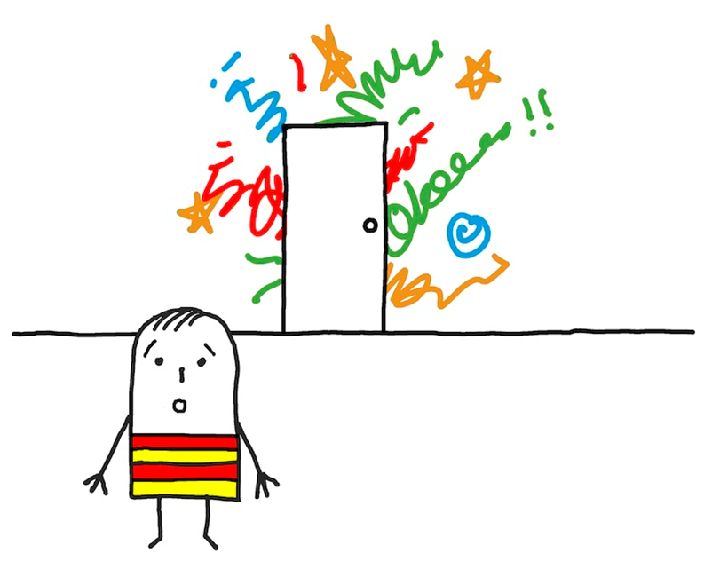
Anxious Behaviour
Avoidance keeps fears going as child never knows if bad things will happen or not and they don’t get the opportunity to develop coping skills
Reassurance can prevent children from learning that they can cope independently
Notes:
HK
Does your child complain about physical symptoms?
How does s/he react to these symptoms?

Slide 13
Reflection time
Think of a time where you might have experienced signs of anxiety in yourself
How did you feel?
What did you do in response?
Example 1: Big work project with bigger responsibilities.
Example 2: Getting to work but there's delays and you might run late to work.
Notes:
HK

Slide 14



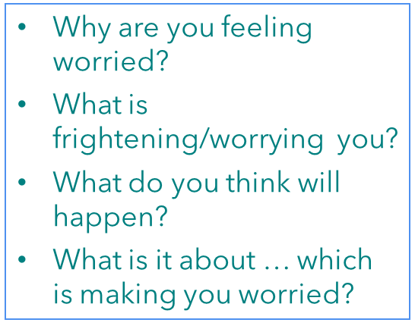

Tips for understanding your child’s anxious thoughts
Picking your moment
Asking open questions
Empathising
The time when you ask about your child’s anxious expectations may make all the difference to your chances of success
Using “what” or “why”
Helping your child feel understood
Normalising
Helping your child feel normal
Notes:
TC
In order to help the child consider alternative thoughts, we first need to understand the child's thoughts.
Picking your moment notes:
Try to ask them at the time, when they are anxious or soon afterwards. If this is not possible pick a time that feels appropriate for them.
Stop if your child is losing concentration or getting cross or frustrated (further troubleshooting tips in the book) (if they are outside their ‘window of tolerance’, they wont be able to think or learn)
Rate level of anxiety- if your child is too anxious you may need to give some time to calm down but be aware of genuine distress; avoidance is the most common safety behaviour for anxiety
Empathising notes:
Convey the message that you can see that they are worried and that you want to understand this better so you can help.
For example you can say “I can see your feeling worried/frightened, that mus[t be really difficult”
Normalising notes:
Let your child know that we all get anxious at times:
“I remember when I got anxious about…”
“ I know that your friend gets worried about…”
“Lots of children get scared and anxious about different things. It’s hard isn’t it?”

Slide 15



Tips for understanding your child’s anxious thoughts
Making suggestions
Checking for understanding
Make it fun or rewarding
It can be helpful to make suggestions if your child says they don’t know...
“so you are worried that… have I got that right?
Helping your child know it’s ok to talk about worries
Notes:
TC
Making suggestions notes: It is important to present suggestions as a question rather than a statement, for example:
Do you think you are worried x might happen?
Some children worry that x might happen. Do you think you are worried about that too?
Checking for understanding notes:
To make sure you have understood what is worrying your child, you need to repeat it back to them and give them the chance to tell you if you’ve got it wrong
Make it fun/rewarding notes: It’s important to try and make talking about anxious expectations a bit more appealing for your child or even fun if you can
Use toys (puppets, mini figures, etc)
Walk and talk: some children may find it easier to talk if they are being active
Thank your child for helping you understand, acknowledge that it can be difficult and follow this with a rewarding activity.
Do you know what your child is anxious about or what they need to learn to overcome anxious thoughts?

Slide 16
The problem with reassurance
Reassurance
All parents reassure their children, it is a natural response, which may reduce distress
Anxious children often seek out reassurance
Persistence of reassurance
It is hard to refrain from giving reassurance, especially when your child is feeling anxious, but giving it may help to maintain the problem
Reassurance may become very repetitive/frequent
Notes:
HK
All parents reassure their children, it is a natural response and in some situations it does help to reduce a child’s distress.
But, we know that anxious children seek out reassurance more.
We also know that continued reassurance does not help the child feel less anxious in the long run. Reassurance can be addictive…
The more parents give reassurance, the more the child will want it! Also the less effective it will be!
Reassurance can actually reinforce the idea that there is something to be anxious about and will stop the child testing out for themselves whether or not their worried and anxious thoughts are accurate. It may also lead to a child thinking they can’t cope without reassurance from parents.

Slide 17
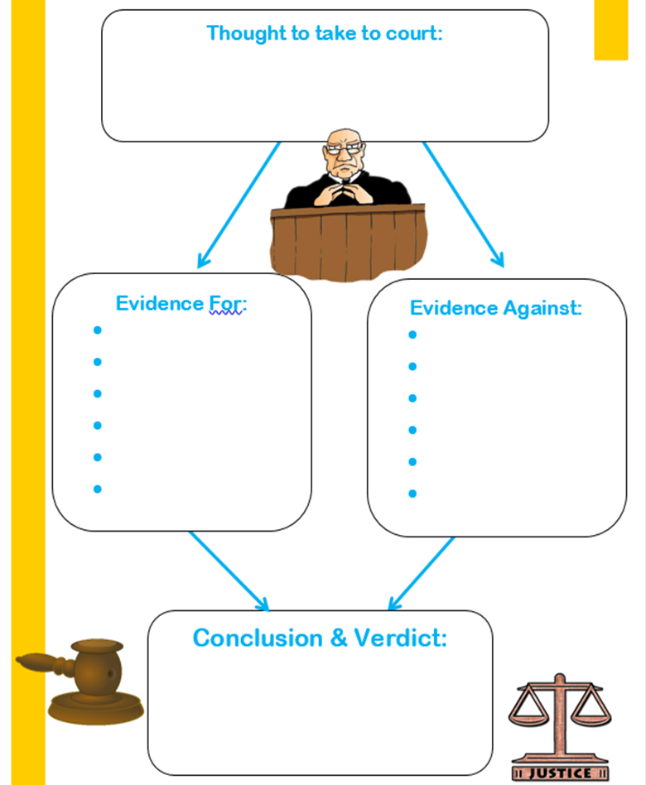
How to cut out reassurance
Empathising, understanding, connecting
Asking questions, not giving answers
Gets children to think for themselves
Helps children to remember the conclusions that were drawn because they have worked them out for themselves
Puts children in control
3. Thinking like a judge in court:
Identify the suspect (the thought) then…
Investigate other suspects (alternative evidence), and then…
Make a judgement about the first suspect; is the thought realistic or helpful
Notes:
HK
1. empathising – showing them you understand
2. Asking questions – identifying what they are anxious about, these anxious predictions / inability to cope
3. Helping them manage this themselves! By thinking like a judge in court
Use typical example based on ages of the children in the room/what the school have suggested:
Separation anxiety at drop off
Secondary transfer/SATs

Slide 18
Building Brave Behaviour
Coming up with alternative thoughts is only one part of the solution.
In order for children to really start to feel different, they need to have a go at trying the things they are scared of.
It is important that children learn to become independent in order to overcome their anxiety and to increase their sense of accomplishment.
They need to learn that they can fight their own battles, without a parent coming to the rescue and have the opportunity to have a go for themselves.
Notes:
TC
Do you find yourself stepping in to help your child a lot? How could you encourage your child to do things for themselves and to feel more independent?
Tell the parents that coming up with alternative thoughts is only one part of the solution. In order for children to really start to feel different, they need to have a go at trying the things they are scared of. Explain that you will be focusing on helping their child to face a particular fear later in this session but in order for their child to do this successfully, it is important that they generally feel more confident about trying things independently and testing out their fears. Explain that there are certain things that others can do to try and promote this behaviour in anxious children and that you will be asking them particular questions about how they may be able to increase these things in order to highlight responses that may be beneficial to their child and that they could increase further.
Promoting independence
•It is important that children learn to become independent in order to overcome their anxiety and to increase their sense of accomplishment.
•They need to learn that they can fight their own battles, without a parent coming to the rescue and have the opportunity to have a go for themselves.
Ask the group if they find themselves stepping in to help their child a lot? How could they encourage their child to do things for themselves and to feel more independent?

Slide 19
Promoting ‘have a go’ Behaviour
Pay attention to your child’s attempts at facing fears and being brave and give as much attention and praise as possible.
Need to give time and attention to the child when they are not showing anxious (or oppositional) behaviours
Rewards are another way of giving your child attention for being brave.
Rewards don’t need to be expensive or cost money, but should fit with the achievement that your child has made
It is important for children to observe other people doing things they might be scared of.
Other people can model being brave.
Notes:
KE
Being on the lookout for ‘have a go’ behaviour
•Pay attention to the child’s attempts at facing fears and being brave and give praise as much as possible.
•This can be hard as parents need to notice the child behaving in a way that might be taken for granted in another child. Ask the group if anyone can think of times when their child has been brave or had a go at something that worried them? Ask if anyone can think of any ideas that might help a child take notice of their accomplishments.
11
This could be supported by:
Attention and praise
give time and attention to the child when they are not showing anxious (or oppositional) behaviours
Can anyone think of things your child currently does despite feeling anxious? Are there ways that you could give this more attention?

Slide 20
Facing Fears
Think back to any difficulties your child had in testing out their fears previously
Some fears may be too overwhelming for a child to simply have a go at…
If this is the case, it is important to build up gradually what they are comfortable with.
Fears wont go away unless we actually stand up to them.
Avoiding things means we never find out whether they were really as bad as we thought and never find ways to deal with them
The only way of overcoming fears is to do the things that make us scared.
Notes:
HK
Has anyone tried to help their child to face fears already? What happened?
Does anyone have concerns about encouraging your child to face their fears?

Slide 21
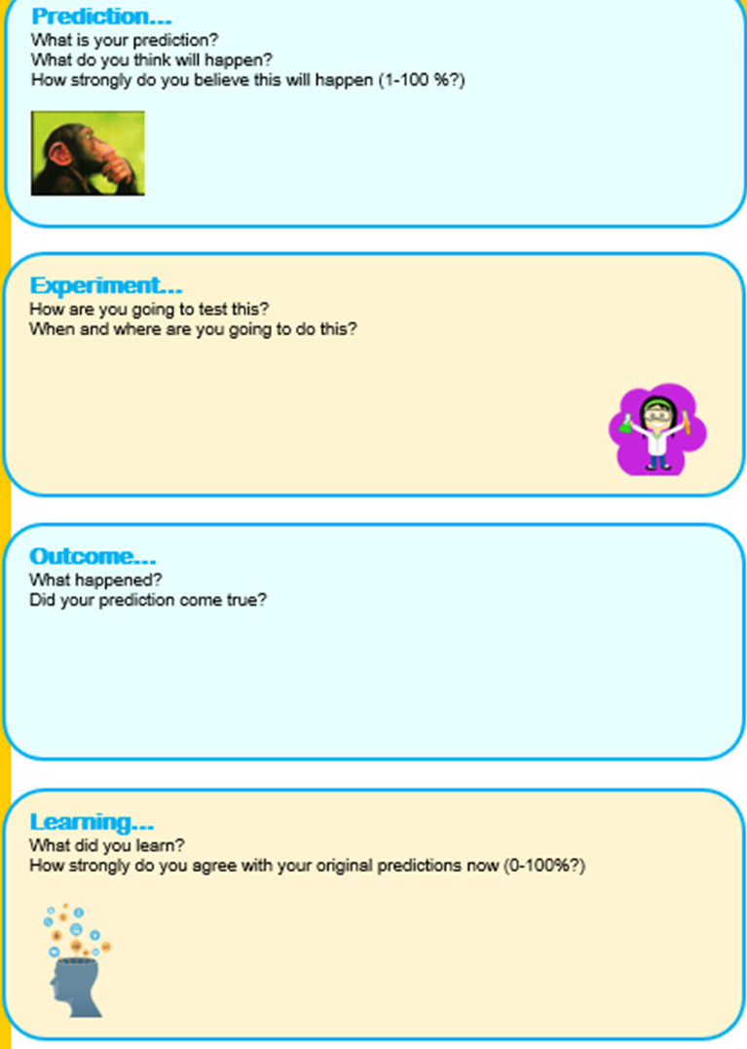
Behaviour Experiments
Helpful when the child is unsure what will happen (e.g. if they have always avoided a particular situation)
The child may feel differently, not just think differently
Notes:
HK
Discuss with service users cavate that if they do not feel comfortable or confident in doing these strategies with their CYP then to not and to seek professional support. They are on a waitlist for professional help and such strategies will likely be covered in more detail with a professional. Also signpost to handouts and to additional reading/resources.
Try to link / give examples based on what parents have mentioned... Or e.g. dog phobia, think a dog will bite you, plan to stroke neighbours dog and see what happens, may actually be fun and enjoy it.. Worry that if get answer wrong will get in trouble, deliberately get answer wrong and see what happens…

Slide 22
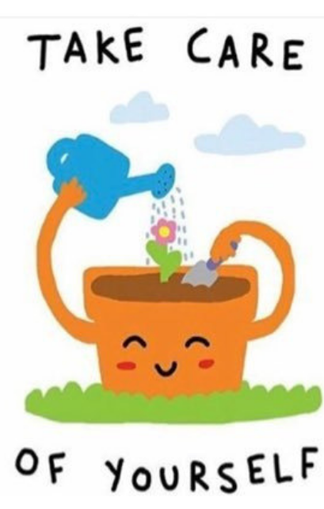
Take Care of You!
Notice when your stress response is activated
Take time out for yourself
Make your bedroom a safe haven for you
Savour something e.g. a song, a cup of tea, a nature walk
Ask for help
Notes:
KE

Slide 23
Helpful Resources
BICS Support Line - 020 8359 3130
Book – Helping Your Child with Fears and Worries by Cathy Creswell
Child Mind Institute - https://childmind.org/topics/anxiety/
Young Minds - https://www.youngminds.org.uk/parent/parents-a-z-mental-health-guide/anxiety/
BICS Online Workshops: https://www.barnet.gov.uk/children-and-families/support-parents-and-carers/barnet-integrated-clinical-services-bics/online
Early Help – www.barnet.gov.uk/0-19
Barnet CAMHS – www.behcamhs.nhs.net.uk
Barnet Crisis Line – 0800 1510 023
Bereavement services - https://www.barnet.gov.uk/directories/support-organisations/barnet-bereavement-service
Bereavement services - https://www.hopeagain.org.uk/
Notes:
HK

Slide 24
Helpful Resources
YouTube videos
Calm App (for kids)
Headspace App (for kids)
Zones of Regulation App
Breathe, Think, Do with Sesame App
Smiling Mind App
Reduce Anxiety with Box Breathing | Katie Sammann Psychotherapy (psychotherapistaustin.com)
Notes:
HK

